Slide 1
St. Louis Central Corridor West Building Permits
January
2020

Slide 2
Introduction
Data retreived from https://www.stlouis-mo.gov/data/
Building permits with a cost of $0 were dropped
Building permits that were cancelled were dropped
Infinite change indicates 0 permits in the current or previous time period/comparison month so there was a overall increase or decrease

Slide 3
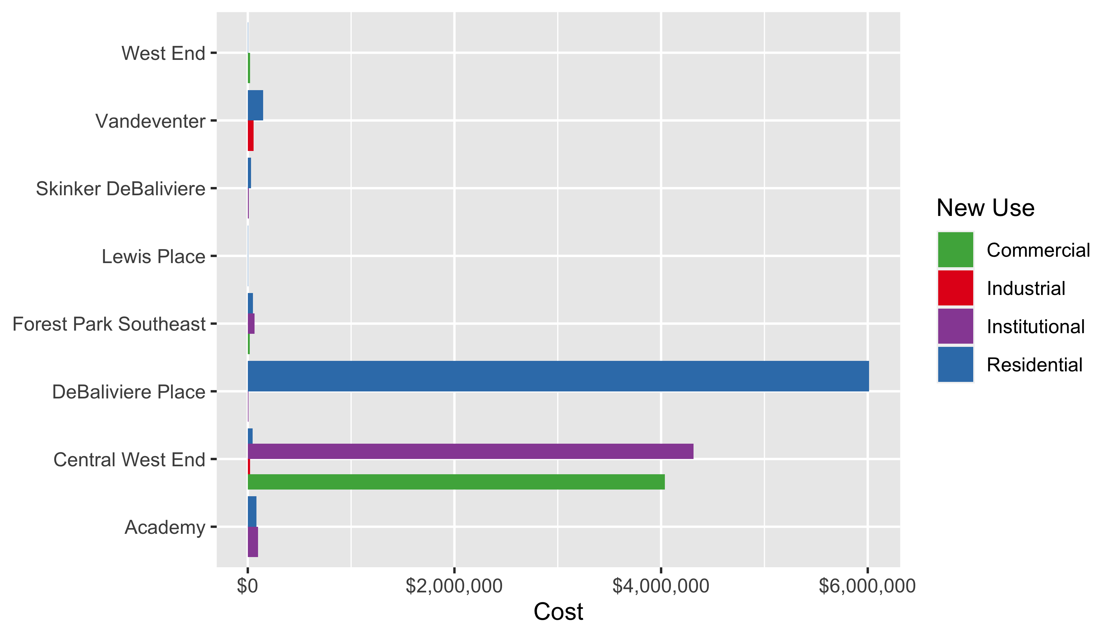
Neighborhood Summary: Average Building Permit Cost

Slide 4
Neighborhood Summary
Neighborhood | Average Cost | # of Permits
Academy | $85,825 | 6
Central West End | $2,091,923 | 37
DeBaliviere Place | $4,512,000 | 4
Forest Park Southeast | $44,015 | 9
Lewis Place | $2,500 | 1
Skinker DeBaliviere | $27,571 | 7
Vandeventer | $102,500 | 2
West End | $8,000 | 10

Slide 5
Forest Park Southeast: Summary Notes
9 building permits in Forest Park Southeast in January 2020
-35.71% change compared to January 2019 (14 total building permits)
$44,015 : Average building permit cost in Forest Park Southeast in January 2020
-70.77% change compared to January 2019 ($150,583)

Slide 6
Forest Park Southeast: Summary Notes
9 total building permits in Forest Park Southeast in 2020
-35.71% change compared to this time in 2019 (14 total building permits)
$44,015 : Average building permit cost in Forest Park Southeast in 2020
-70.77% change compared to this time in 2019 ($150,583)

Slide 7
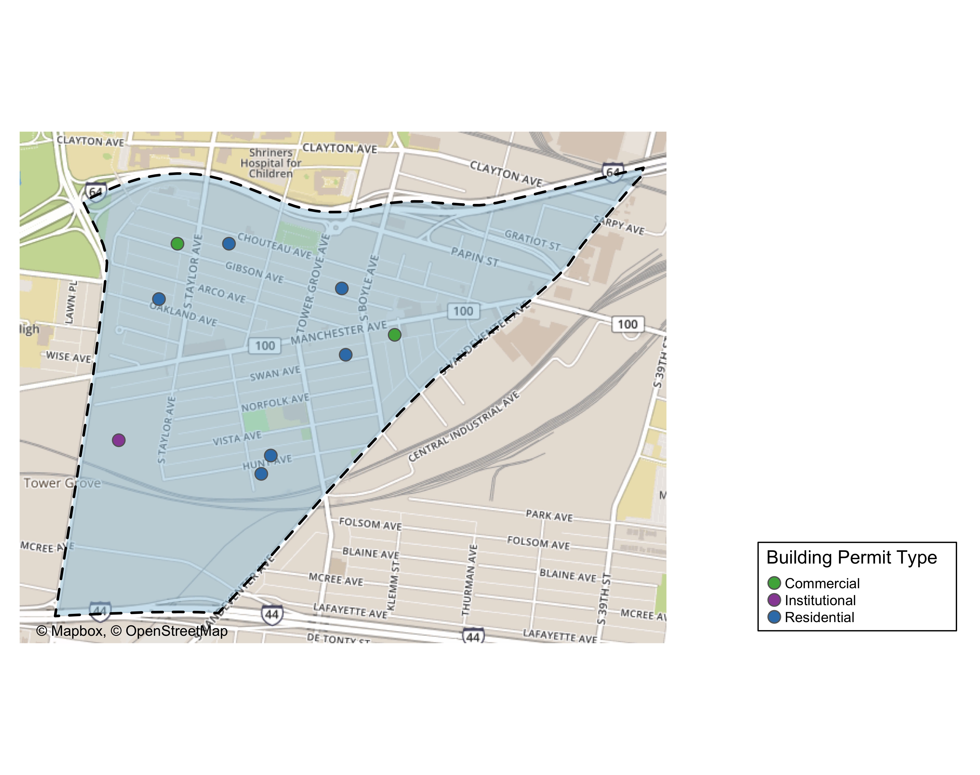
Forest Park Southeast

Slide 8
Forest Park Southeast
New Use | Average Cost | # of Permits
Commercial | $17,500 | 2
Institutional | $64,145 | 1
Residential | $49,498 | 6

Slide 9
Forest Park Southeast Individual Permit Breakdown
Owner | New Use | Cost | address
MITCHELL, TIMOTHY J | Residential | $3,000 | 4535 OAKLAND AV
ROBBINS, ARNOLD J & TERRIE L | Residential | $250,000 | 4353 HUNT AV
ALBIN, MICHAEL & LISA | Residential | $3,990 | 4227 SWAN AV
WASHINGTON UNIVERSITY | Institutional | $64,145 | 1234 S KINGSHIGHWAY BLVD
TISOTO, JEFFREY & LYNNE | Commercial | $15,000 | 4523 GIBSON AV
VITT, VICTOR J JR | Residential | $9,000 | 4366 HUNT AV
4176 MANCHESTER LLC | Commercial | $20,000 | 4176 MANCHESTER AV
KAMPE, NICHOLAS R | Residential | $30,000 | 4448 CHOUTEAU AV
JOHNSON, ISAIAH & CALLIE | Residential | $1,000 | 4327 GIBSON AV

Slide 10
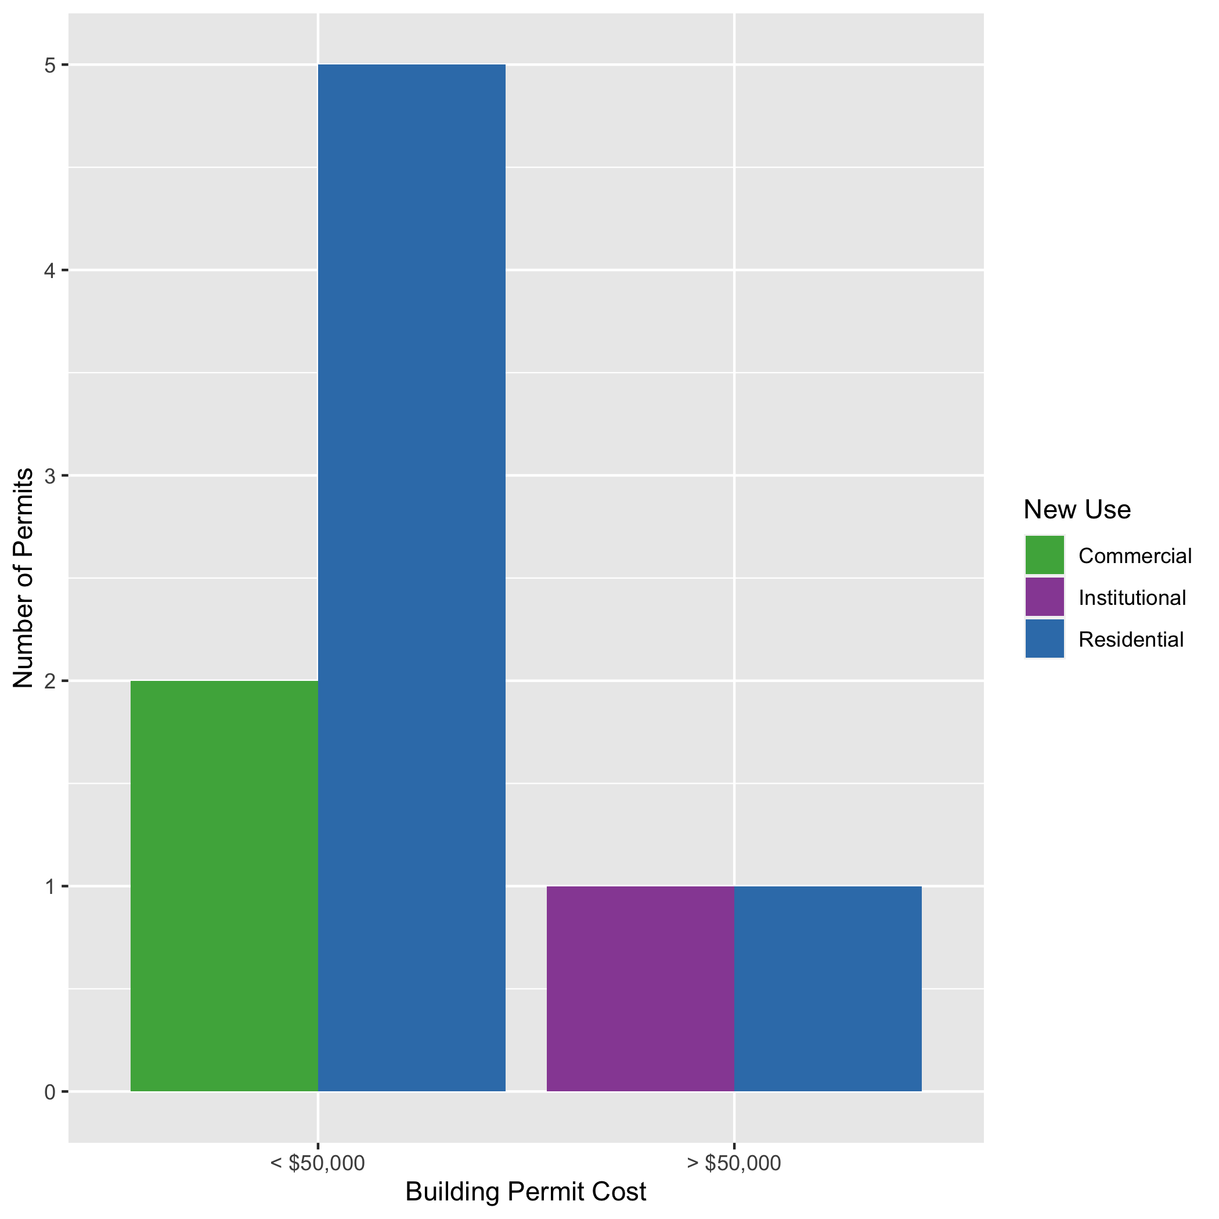
Forest Park Southeast High Cost Permits

Slide 11
Central West End: Summary Notes
37 building permits in Central West End in January 2020
-26.00% change compared to January 2019 (50 total building permits)
$2,091,923 : Average building permit cost in Central West End in January 2020
865.25% change compared to January 2019 ($216,724)

Slide 12
Central West End: Summary Notes
37 total building permits in Central West End in 2020
-26.00% change compared to this time in 2019 (50 total building permits)
$2,091,923 : Average building permit cost in Central West End in 2020
865.25% change compared to this time in 2019 ($216,724)

Slide 13
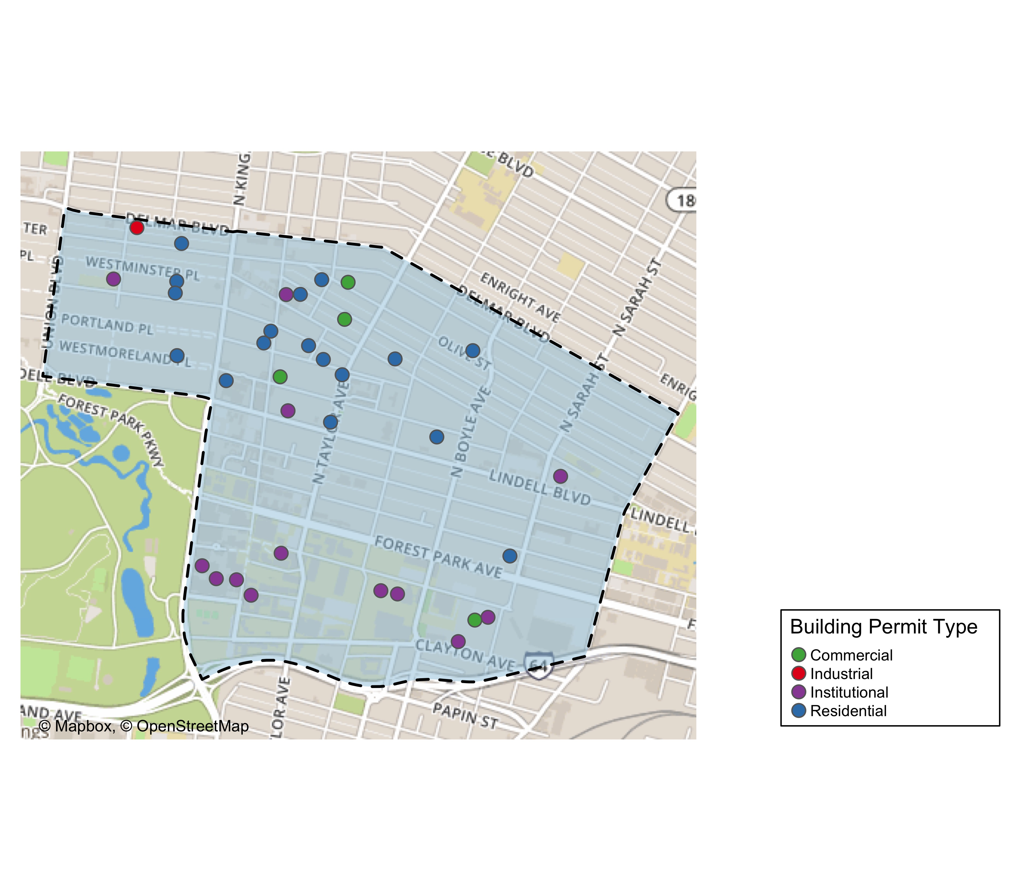
Central West End

Slide 14
Central West End
New Use | Average Cost | # of Permits
Commercial | $4,037,500 | 4
Industrial | $21,676 | 1
Institutional | $4,313,105 | 14
Residential | $47,000 | 18

Slide 15
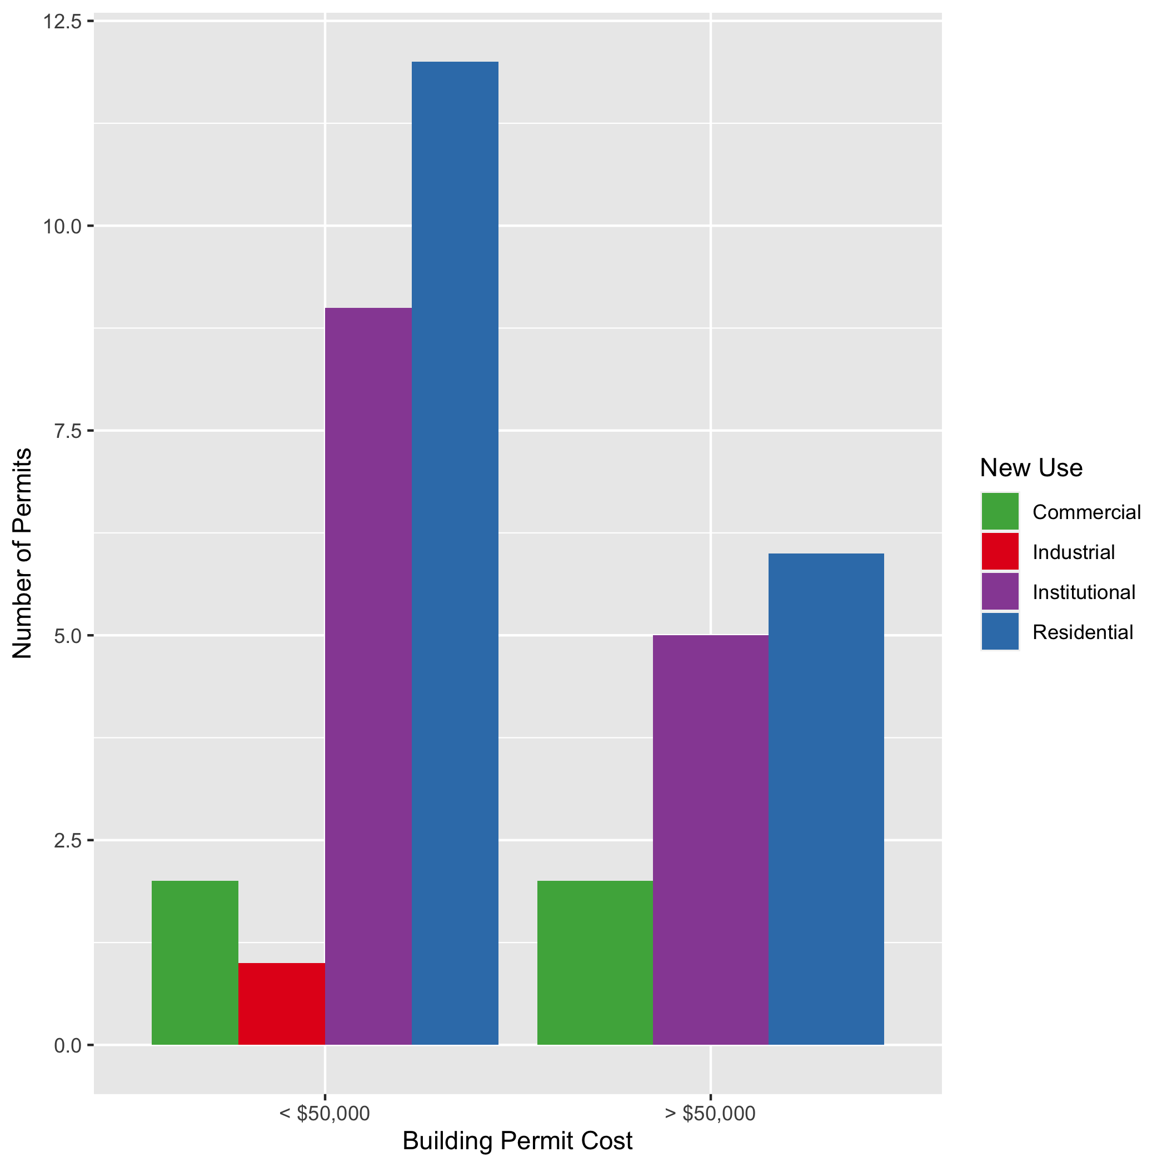
Cental West End High Cost Permits

Slide 16
DeBaliviere Place: Summary Notes
4 building permits in DeBaliviere Place in January 2020
-50.00% change compared to January 2019 (8 total building permits)
$4,512,000 : Average building permit cost in DeBaliviere Place in January 2020
17220.54% change compared to January 2019 ($26,050)

Slide 17
DeBaliviere Place: Summary Notes
4 total building permits in DeBaliviere Place in 2020
-50.00% change compared to this time in 2019 (8 total building permits)
$4,512,000 : Average building permit cost in DeBaliviere Place in 2020
17220.54% change compared to this time in 2019 ($26,050)

Slide 18
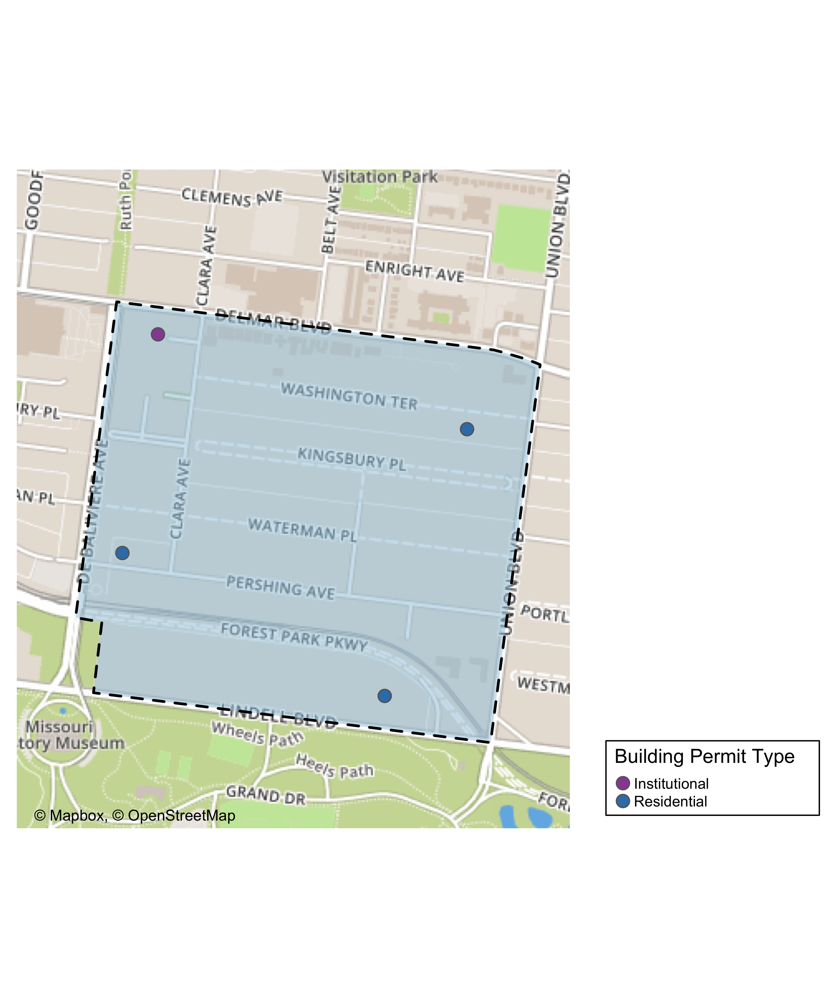
DeBaliviere Place

Slide 19
DeBaliviere Place
New Use | Average Cost | # of Permits
Institutional | $8,000 | 1
Residential | $6,013,333 | 3

Slide 20
DeBaliviere Place Individual Permit Breakdown
Owner | New Use | Cost | Address
DEL MONTE APARTMENTS LLC | Institutional | $8,000 | 5622 DELMAR BLVD
REDIGER, DOUGLAS HTRS | Residential | $35,000 | 5373 LINDELL BLVD
KILAMANJARO V LLC | Residential | $18,000,000 | 5637 PERSHING AV
CALHOUN, BARRY & SHIRA SPETNER | Residential | $5,000 | 10 WASHINGTON TER

Slide 21
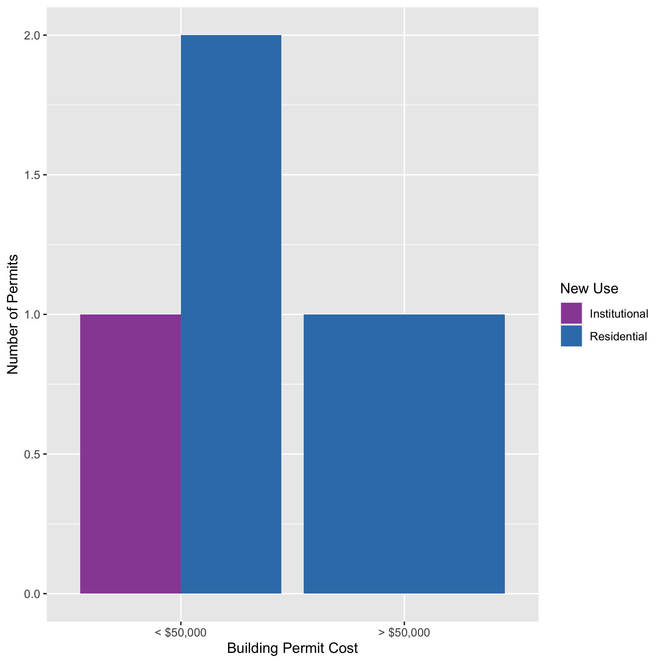
DeBaliviere Place High Cost Permits

Slide 22
Skinker DeBaliviere: Summary Notes
7 building permits in Skinker DeBaliviere in January 2020
16.67% change compared to January 2019 (6 total building permits)
$27,571 : Average building permit cost in Skinker DeBaliviere in January 2020
-19.31% change compared to January 2019 ($34,170)

Slide 23
Skinker DeBaliviere: Summary Notes
7 total building permits in Skinker DeBaliviere in 2020
16.67% change compared to this time in 2019 (6 total building permits)
$27,571 : Average building permit cost in Skinker DeBaliviere in 2020
-19.31% change compared to this time in 2019 ($34,170)

Slide 24
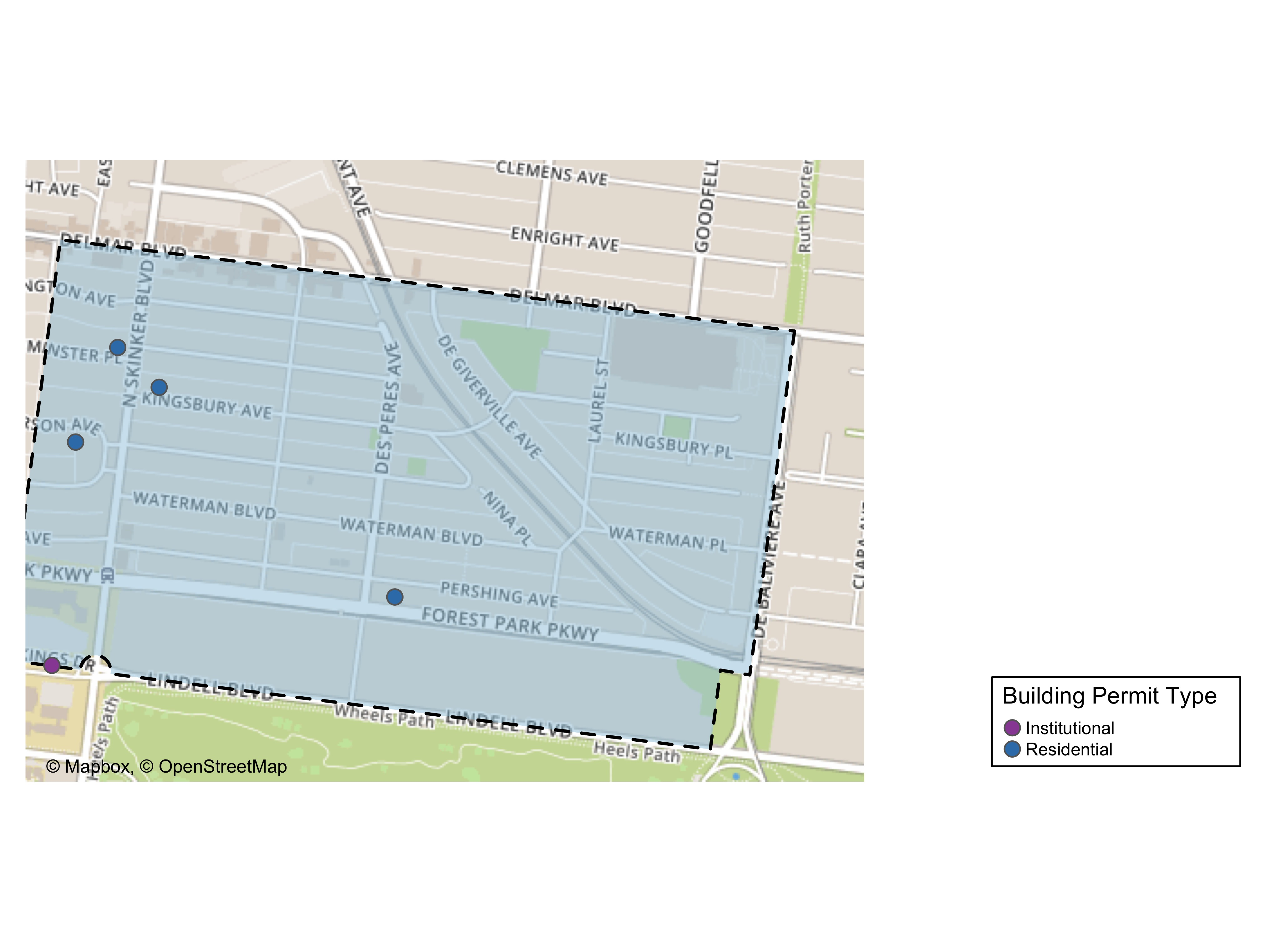
Skinker DeBaliviere

Slide 25
Skinker DeBaliviere
New Use | Average Cost | # of Permits
Institutional | $10,000 | 1
Residential | $30,500 | 6

Slide 26
Skinker DeBaliviere Individual Permit Breakdown
Owner | New Use | Cost | Address
DEE, MICHAEL PATRICK & | Residential | $76,500 | 6232 MCPHERSON AV
HOFFMAN, CHERI L | Residential | $27,000 | 6211 WESTMINSTER PL
WELCH, MARGARET & MARY LOU | Residential | $17,500 | 6189 KINGSBURY AV
WASHINGTON UNIVERSITY ART BUILDING | Institutional | $10,000 | 6220 FOREST PARK PARKWAY
ONE WORLD - USA, LLC | Residential | $33,000 | 5948 PERSHING AV
ONE WORLD - USA, LLC | Residential | $14,000 | 5948 PERSHING AV
DEE, MICHAEL PATRICK & | Residential | $15,000 | 6232 MCPHERSON AV

Slide 27
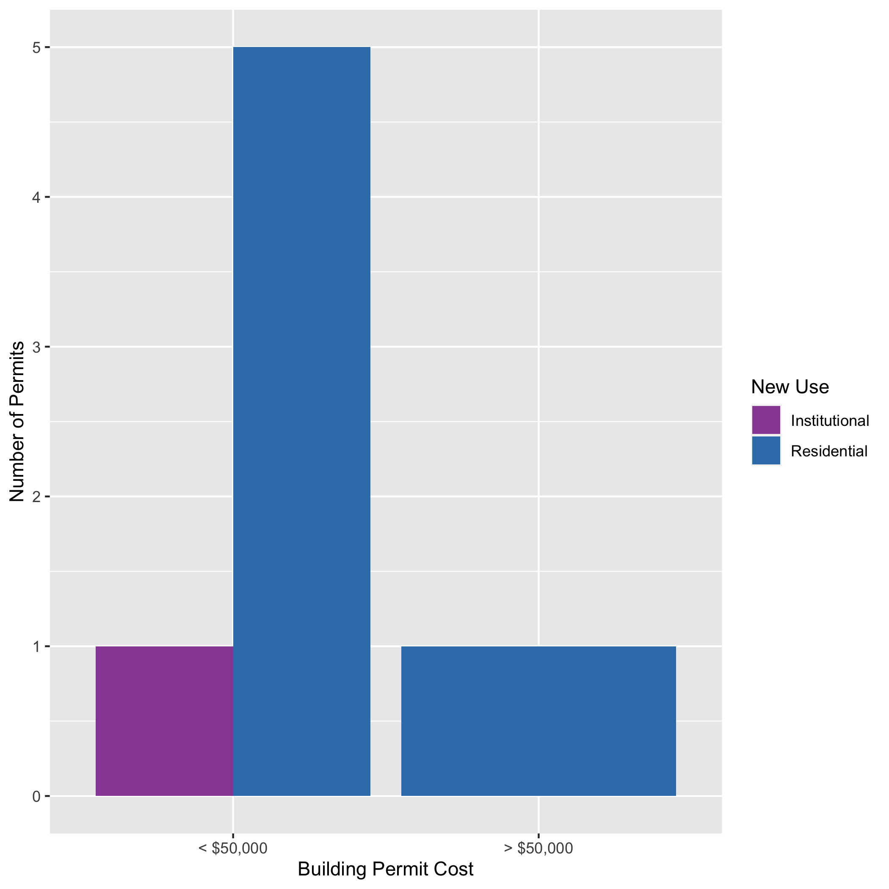
Skinker DeBaliviere High Cost Permits

Slide 28
West End: Summary Notes
10 building permits in West End in January 2020
150.00% change compared to January 2019 (4 total building permits)
$8,000 : Average building permit cost in West End in January 2020
-97.49% change compared to January 2019 ($318,350)

Slide 29
West End: Summary Notes
10 total building permits in West End in 2020
150.00% change compared to this time in 2019 (4 total building permits)
$8,000 : Average building permit cost in West End in 2020
-97.49% change compared to this time in 2019 ($318,350)

Slide 30
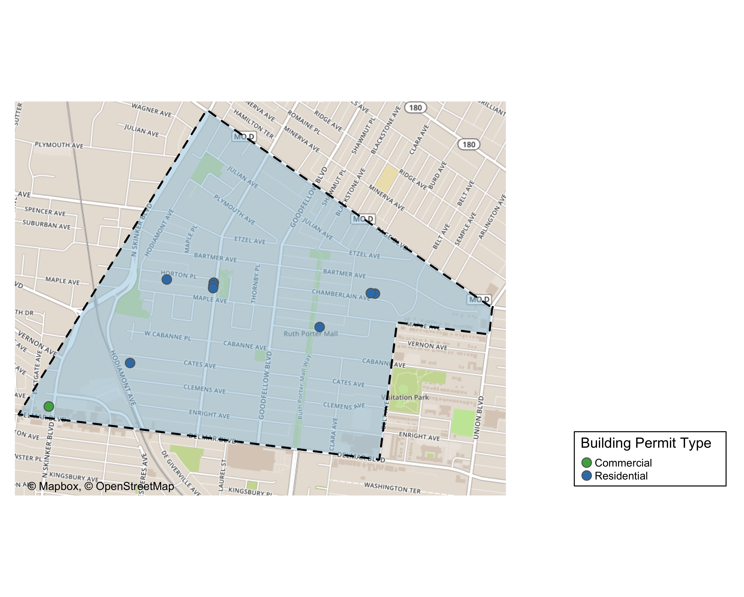
West End

Slide 31
West End
New Use | Average Cost | # of Permits
Commercial | $21,000 | 2
Residential | $4,750 | 8

Slide 32
West End Individual Permit Breakdown
Owner | New Use | Cost | Address
KEY MASTERS LLC | Residential | $2,000 | 5647 VERNON AV
THREE DOORS PROPERTIES LLC | Residential | $30,000 | 6018 HORTON PL
WESTEND CATES LLC | Residential | $1,000 | 6062 CATES AV
WESTEND CHAMBERLAIN LLC | Residential | $1,000 | 5561-5565 CHAMBERLAIN AV
WESTEND CHAMBERLAIN LLC | Residential | $1,000 | 5569-5571 CHAMBERLAIN AV
WESTEND HAMILTON LLC | Residential | $1,000 | 5902-5906 HORTON PL
WESTEND HAMILTON LLC | Residential | $1,000 | 1019-1021 HAMILTON AV
WESTEND HAMILTON LLC | Residential | $1,000 | 1023-1025 HAMILTON AV
PACE-DELMAR ASSOCIATES LLC | Commercial | $10,000 | 621 N SKINKER BLVD
PACE-DELMAR ASSOCIATES LLC | Commercial | $32,000 | 6211 DELMAR BLVD

Slide 33
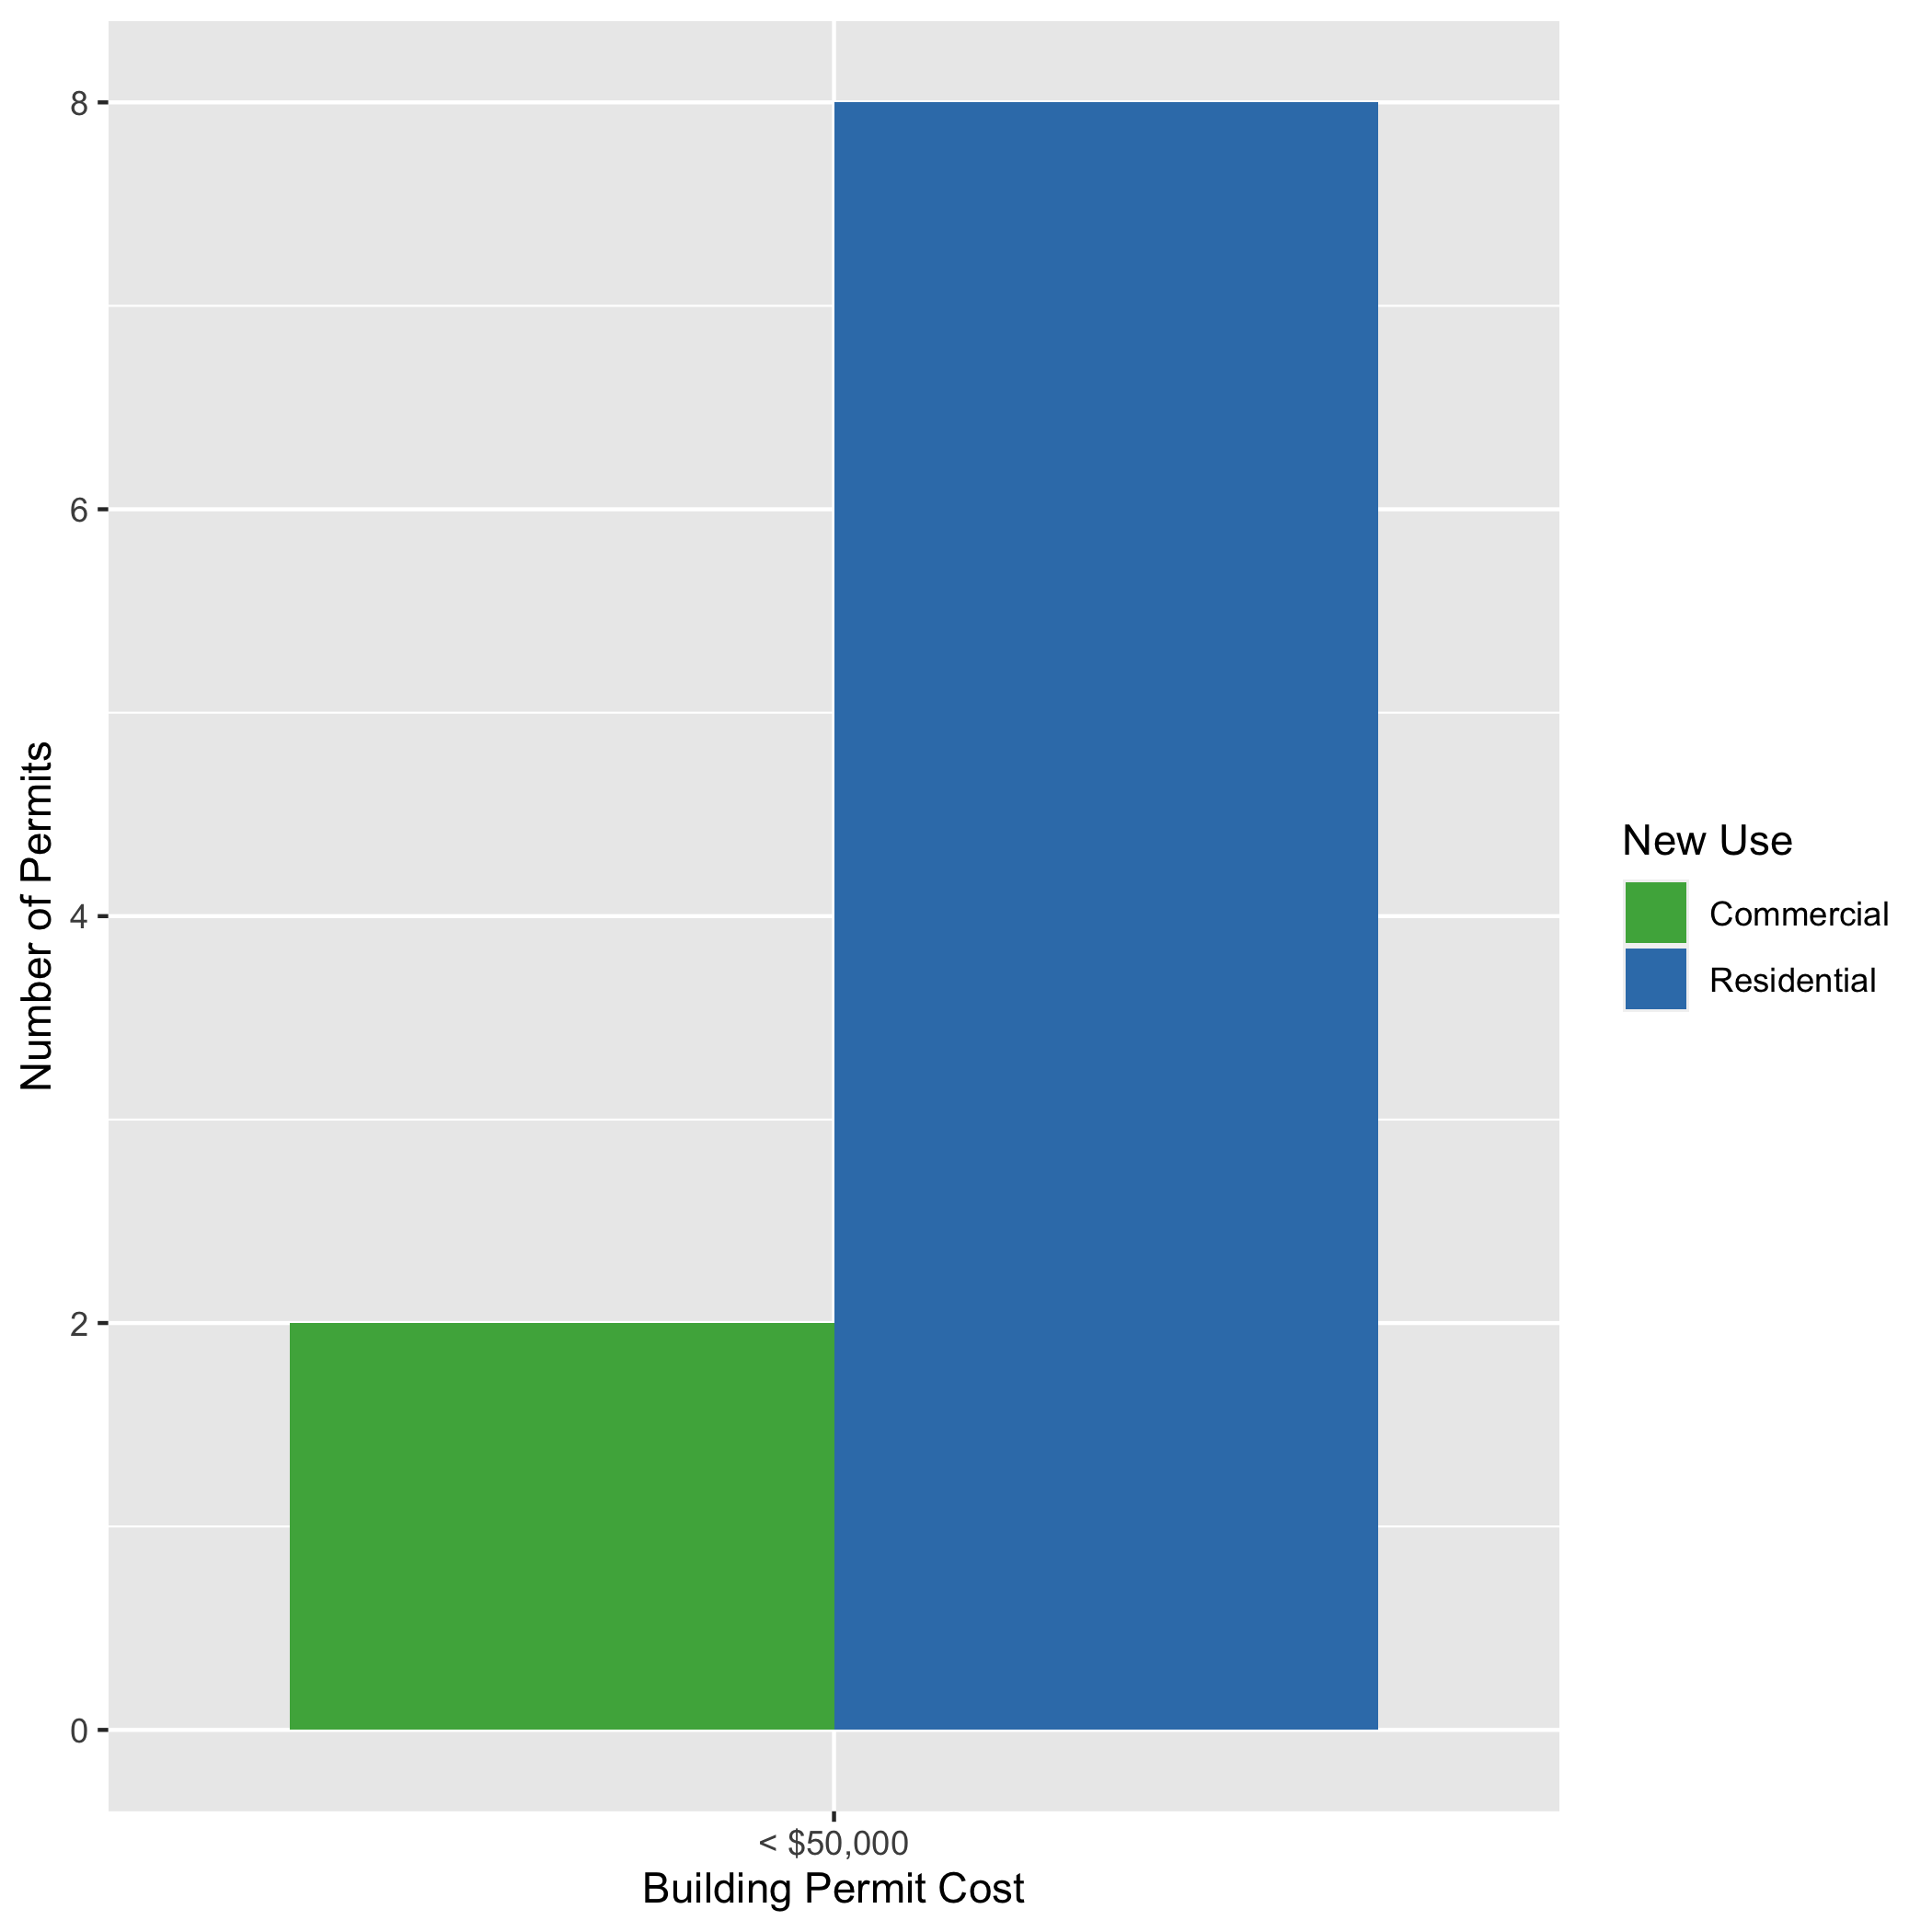
West End High Cost Permits

Slide 34
Visitation Park: Summary Notes
0 building permits in Visitation Park in January 2020
0.00% change compared to January 2019 (0 total building permits)
$0 : Average building permit cost in Visitation Park in January 2020
0.00% change compared to January 2019 ($0)

Slide 35
Visitation Park: Summary Notes
0 total building permits in Visitation Park in 2020
0.00% change compared to this time in 2019 (0 total building permits)
$0 : Average building permit cost in Visitation Park in 2020
0.00% change compared to this time in 2019 ($0)

Slide 36
Academy: Summary Notes
6 building permits in Academy in January 2020
100.00% change compared to January 2019 (3 total building permits)
$85,825 : Average building permit cost in Academy in January 2020
-8.12% change compared to January 2019 ($93,405)

Slide 37
Academy: Summary Notes
6 total building permits in Academy in 2020
100.00% change compared to this time in 2019 (3 total building permits)
$85,825 : Average building permit cost in Academy in 2020
-8.12% change compared to this time in 2019 ($93,405)

Slide 38
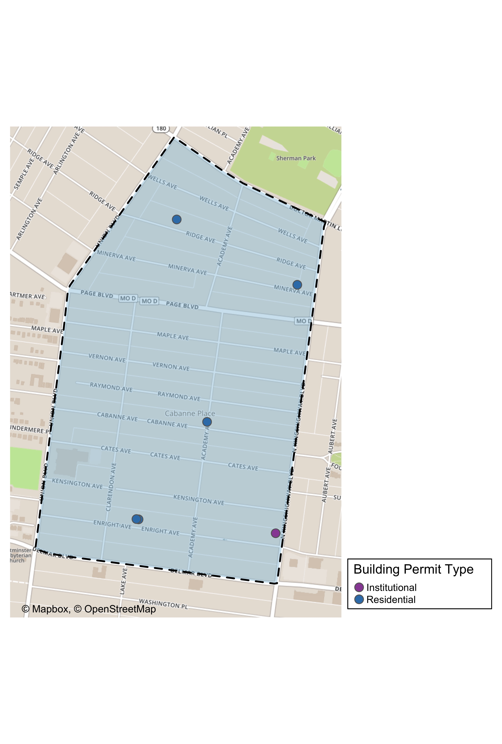
Academy

Slide 39
Academy
New Use | Average Cost | # of Permits
Institutional | $100,000 | 1
Residential | $82,990 | 5

Slide 40
Academy Individual Permit Breakdown
Owner | New Use | Cost | Address
MCCLENDON, GARY & GENA | Residential | $1,500 | 5021 MINERVA AV
GREEN LINE LLC | Residential | $200,000 | 5169 ENRIGHT AV
GREEN LINE LLC | Residential | $200,000 | 5167 ENRIGHT AV
MURPHY, CHRISTINA | Residential | $8,450 | 5101 CABANNE AV
LAVINCENT HOOKER | Institutional | $100,000 | 813 N KINGSHIGHWAY BLVD
JONES, ELLA M | Residential | $5,000 | 5207 RIDGE AV

Slide 41
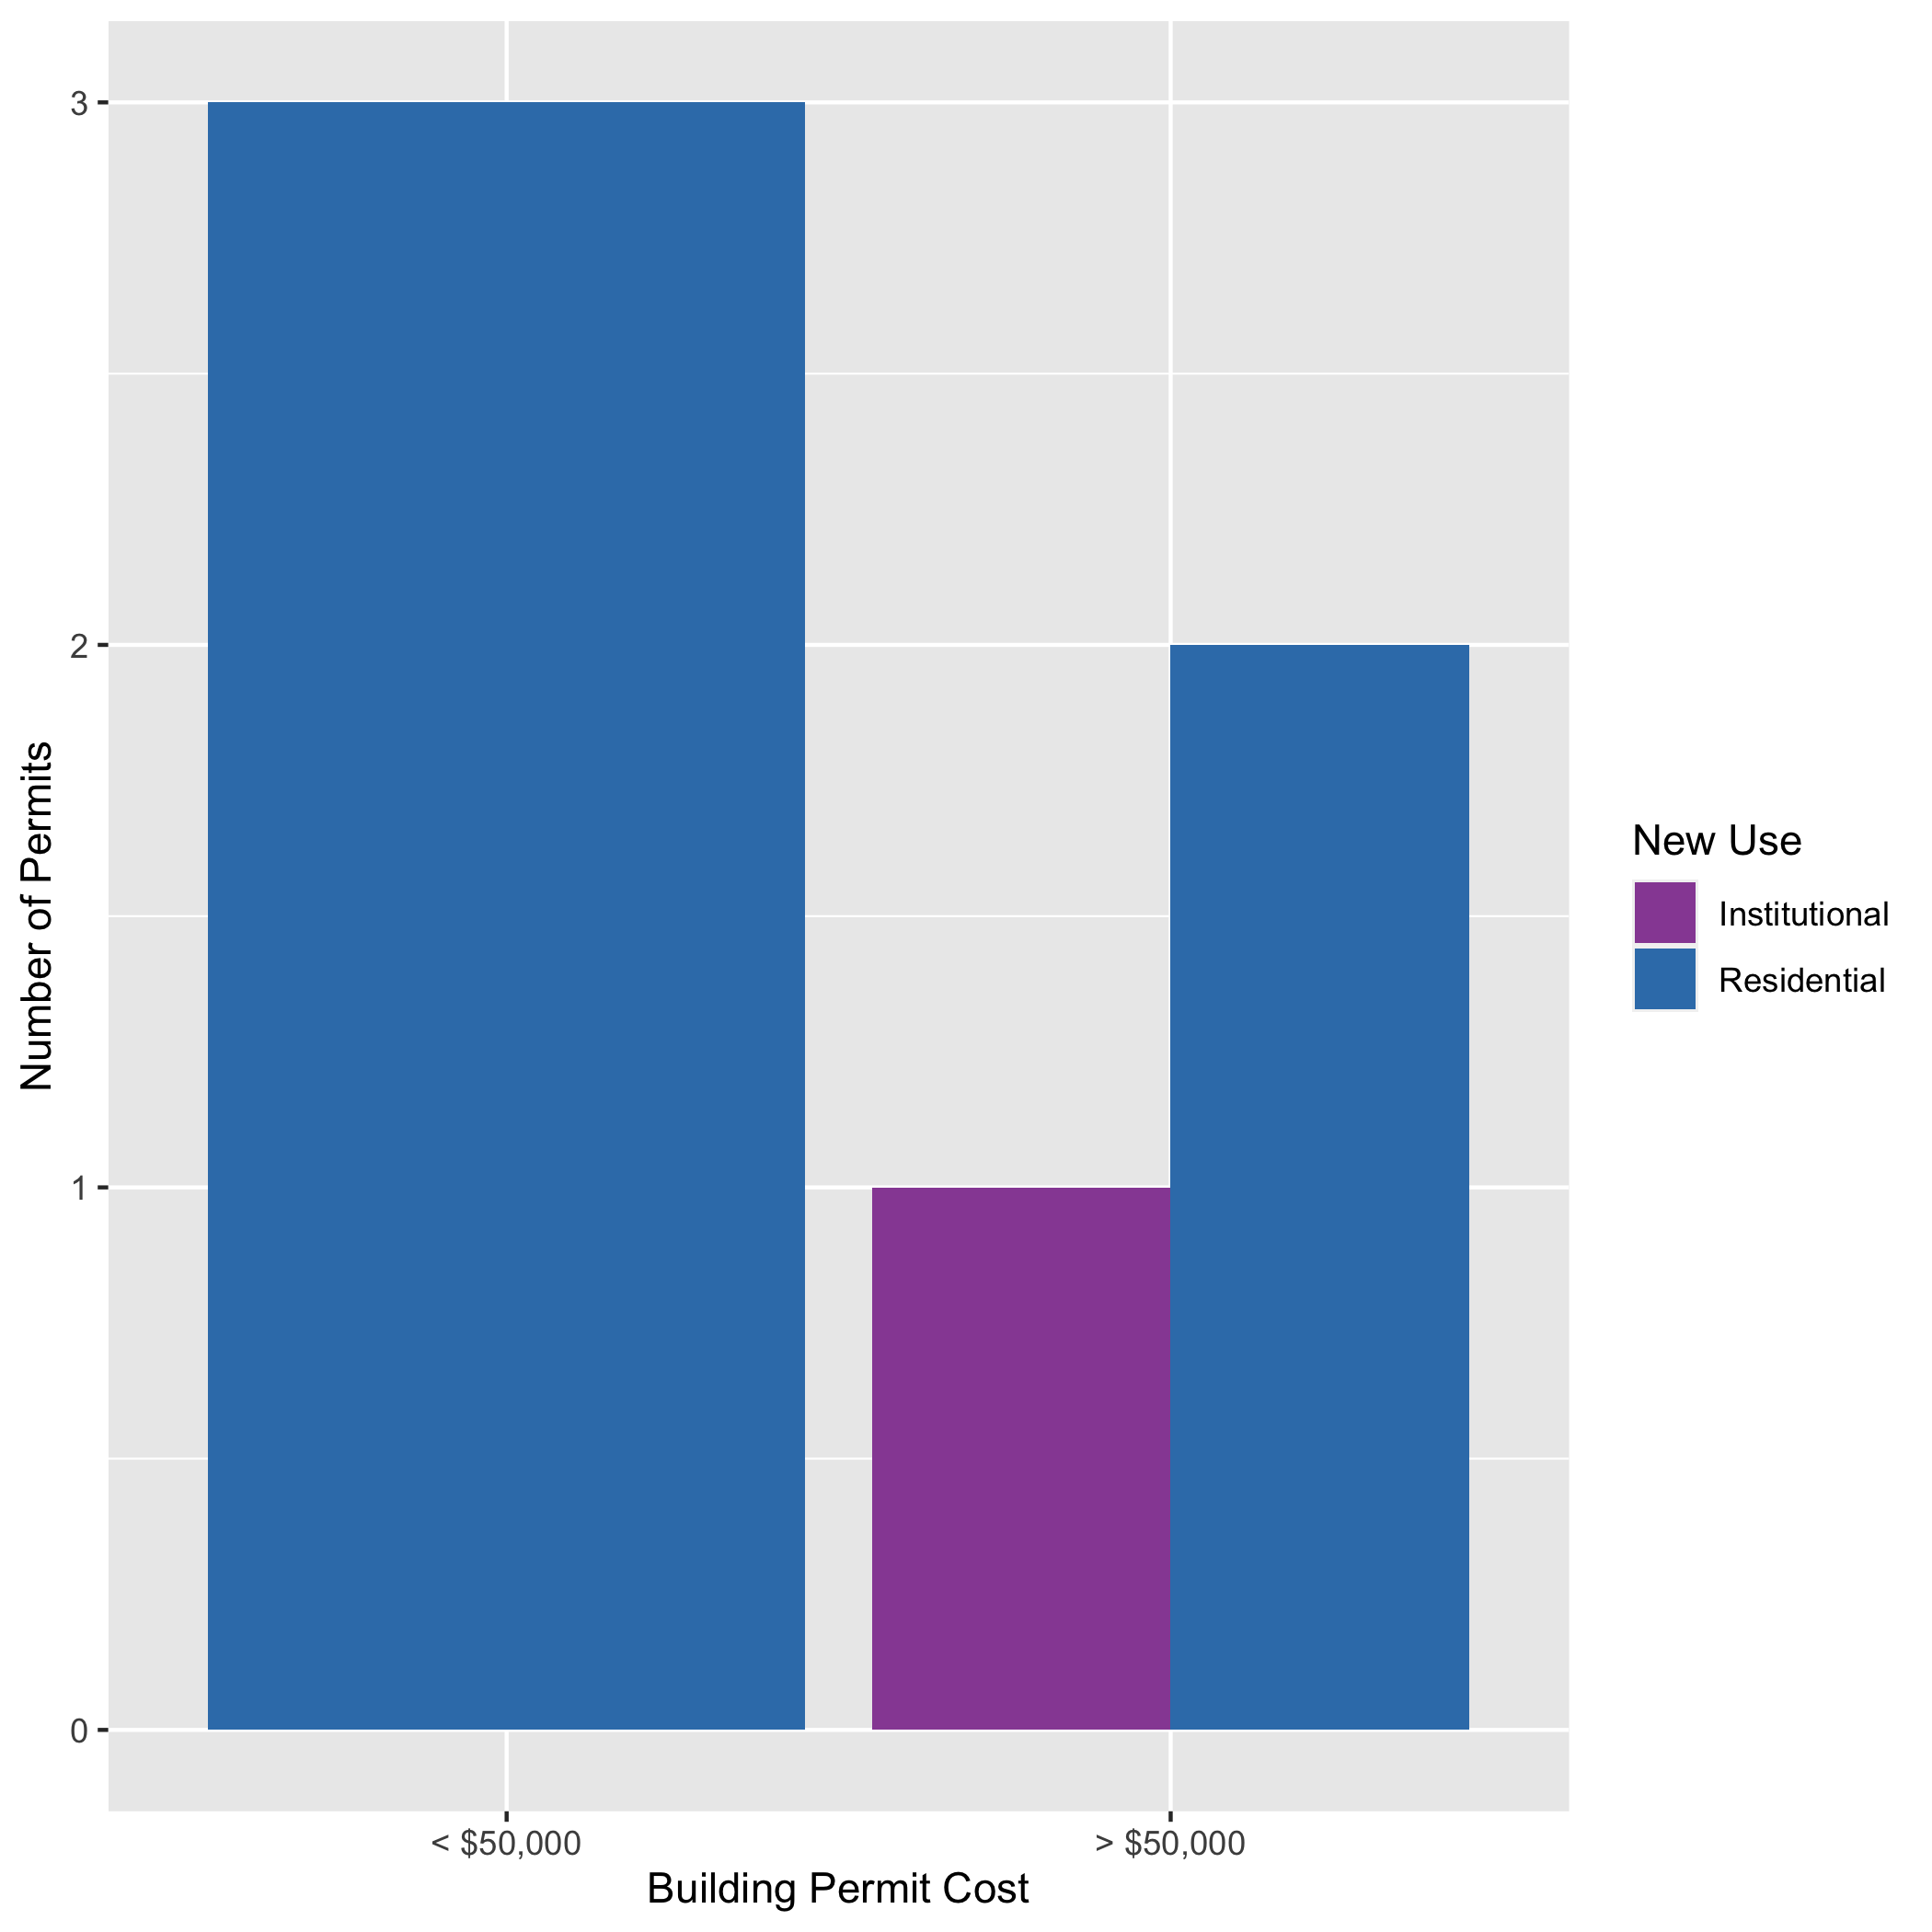
Academy High Cost Permits

Slide 42
Fountain Park: Summary Notes
0 building permits in Fountain Park in January 2020
-100.00% change compared to January 2019 (1 total building permits)
$0 : Average building permit cost in Fountain Park in January 2020
-100.00% change compared to January 2019 ($500)

Slide 43
Fountain Park: Summary Notes
0 total building permits in Fountain Park 2020
-100.00% change compared to this time in 2019 (1 total building permits)
$0 : Average building permit cost in Fountain Park in 2020
-100.00% change compared to this time in 2019 ($500)

Slide 44
Lewis Place: Summary Notes
1 building permits in Lewis Place in January 2020
-50.00% change compared to January 2019 (2 total building permits)
$2,500 : Average building permit cost in Lewis Place in January 2020
-73.68% change compared to January 2019 ($9,500)

Slide 45
Lewis Place: Summary Notes
1 total building permits in Lewis Place in 2020
-50.00% change compared to this time in 2019 (2 total building permits)
$2,500 : Average building permit cost in Lewis Place in 2020
-73.68% change compared to this time in 2019 ($9,500)

Slide 46
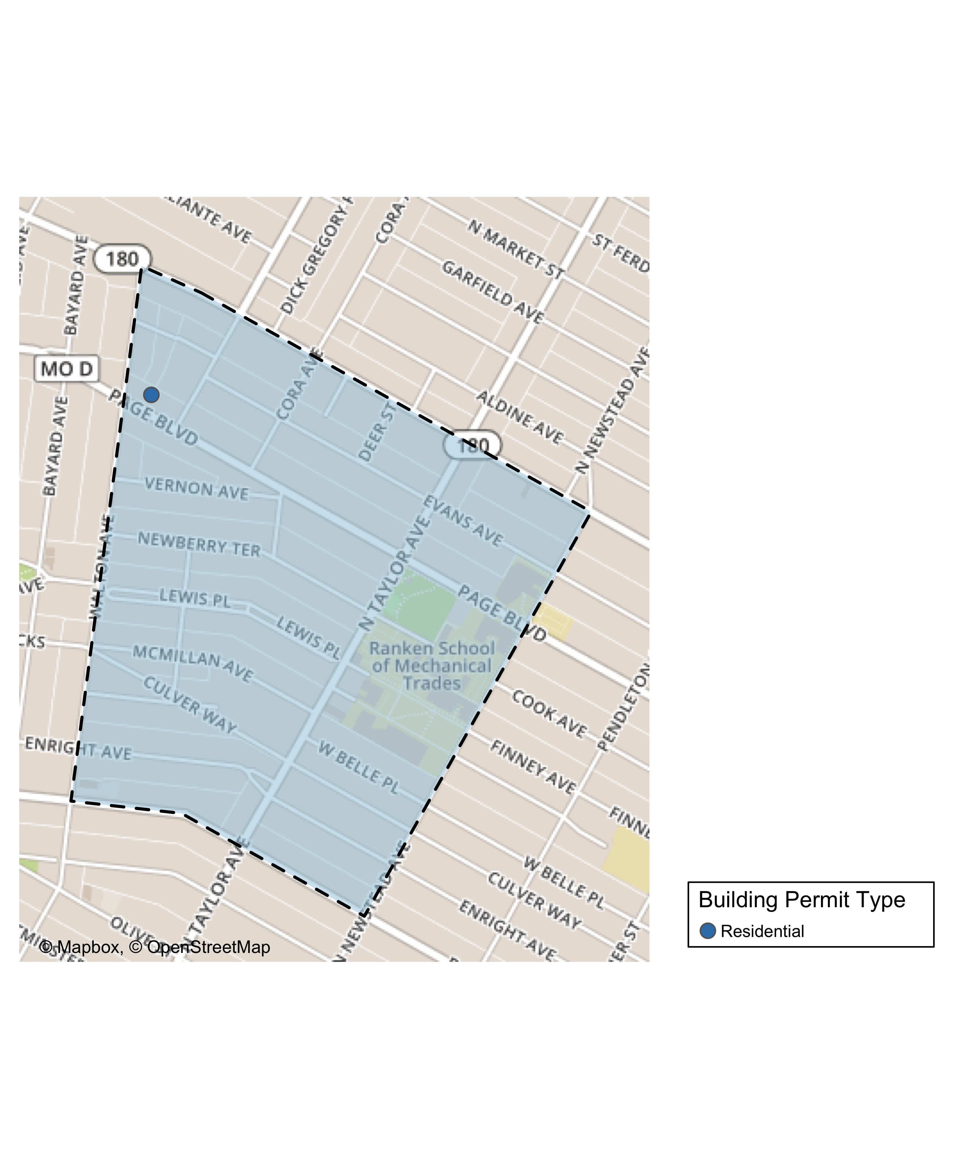
Lewis Place

Slide 47
Lewis Place
New Use | Average Cost | # of Permits
Residential | $2,500 | 1

Slide 48
Lewis Place Individual Permit Breakdown
Owner | New Use | Cost | Address
GRAVES, JOHN E | Residential | $2,500 | 4727 PAGE BLVD

Slide 49
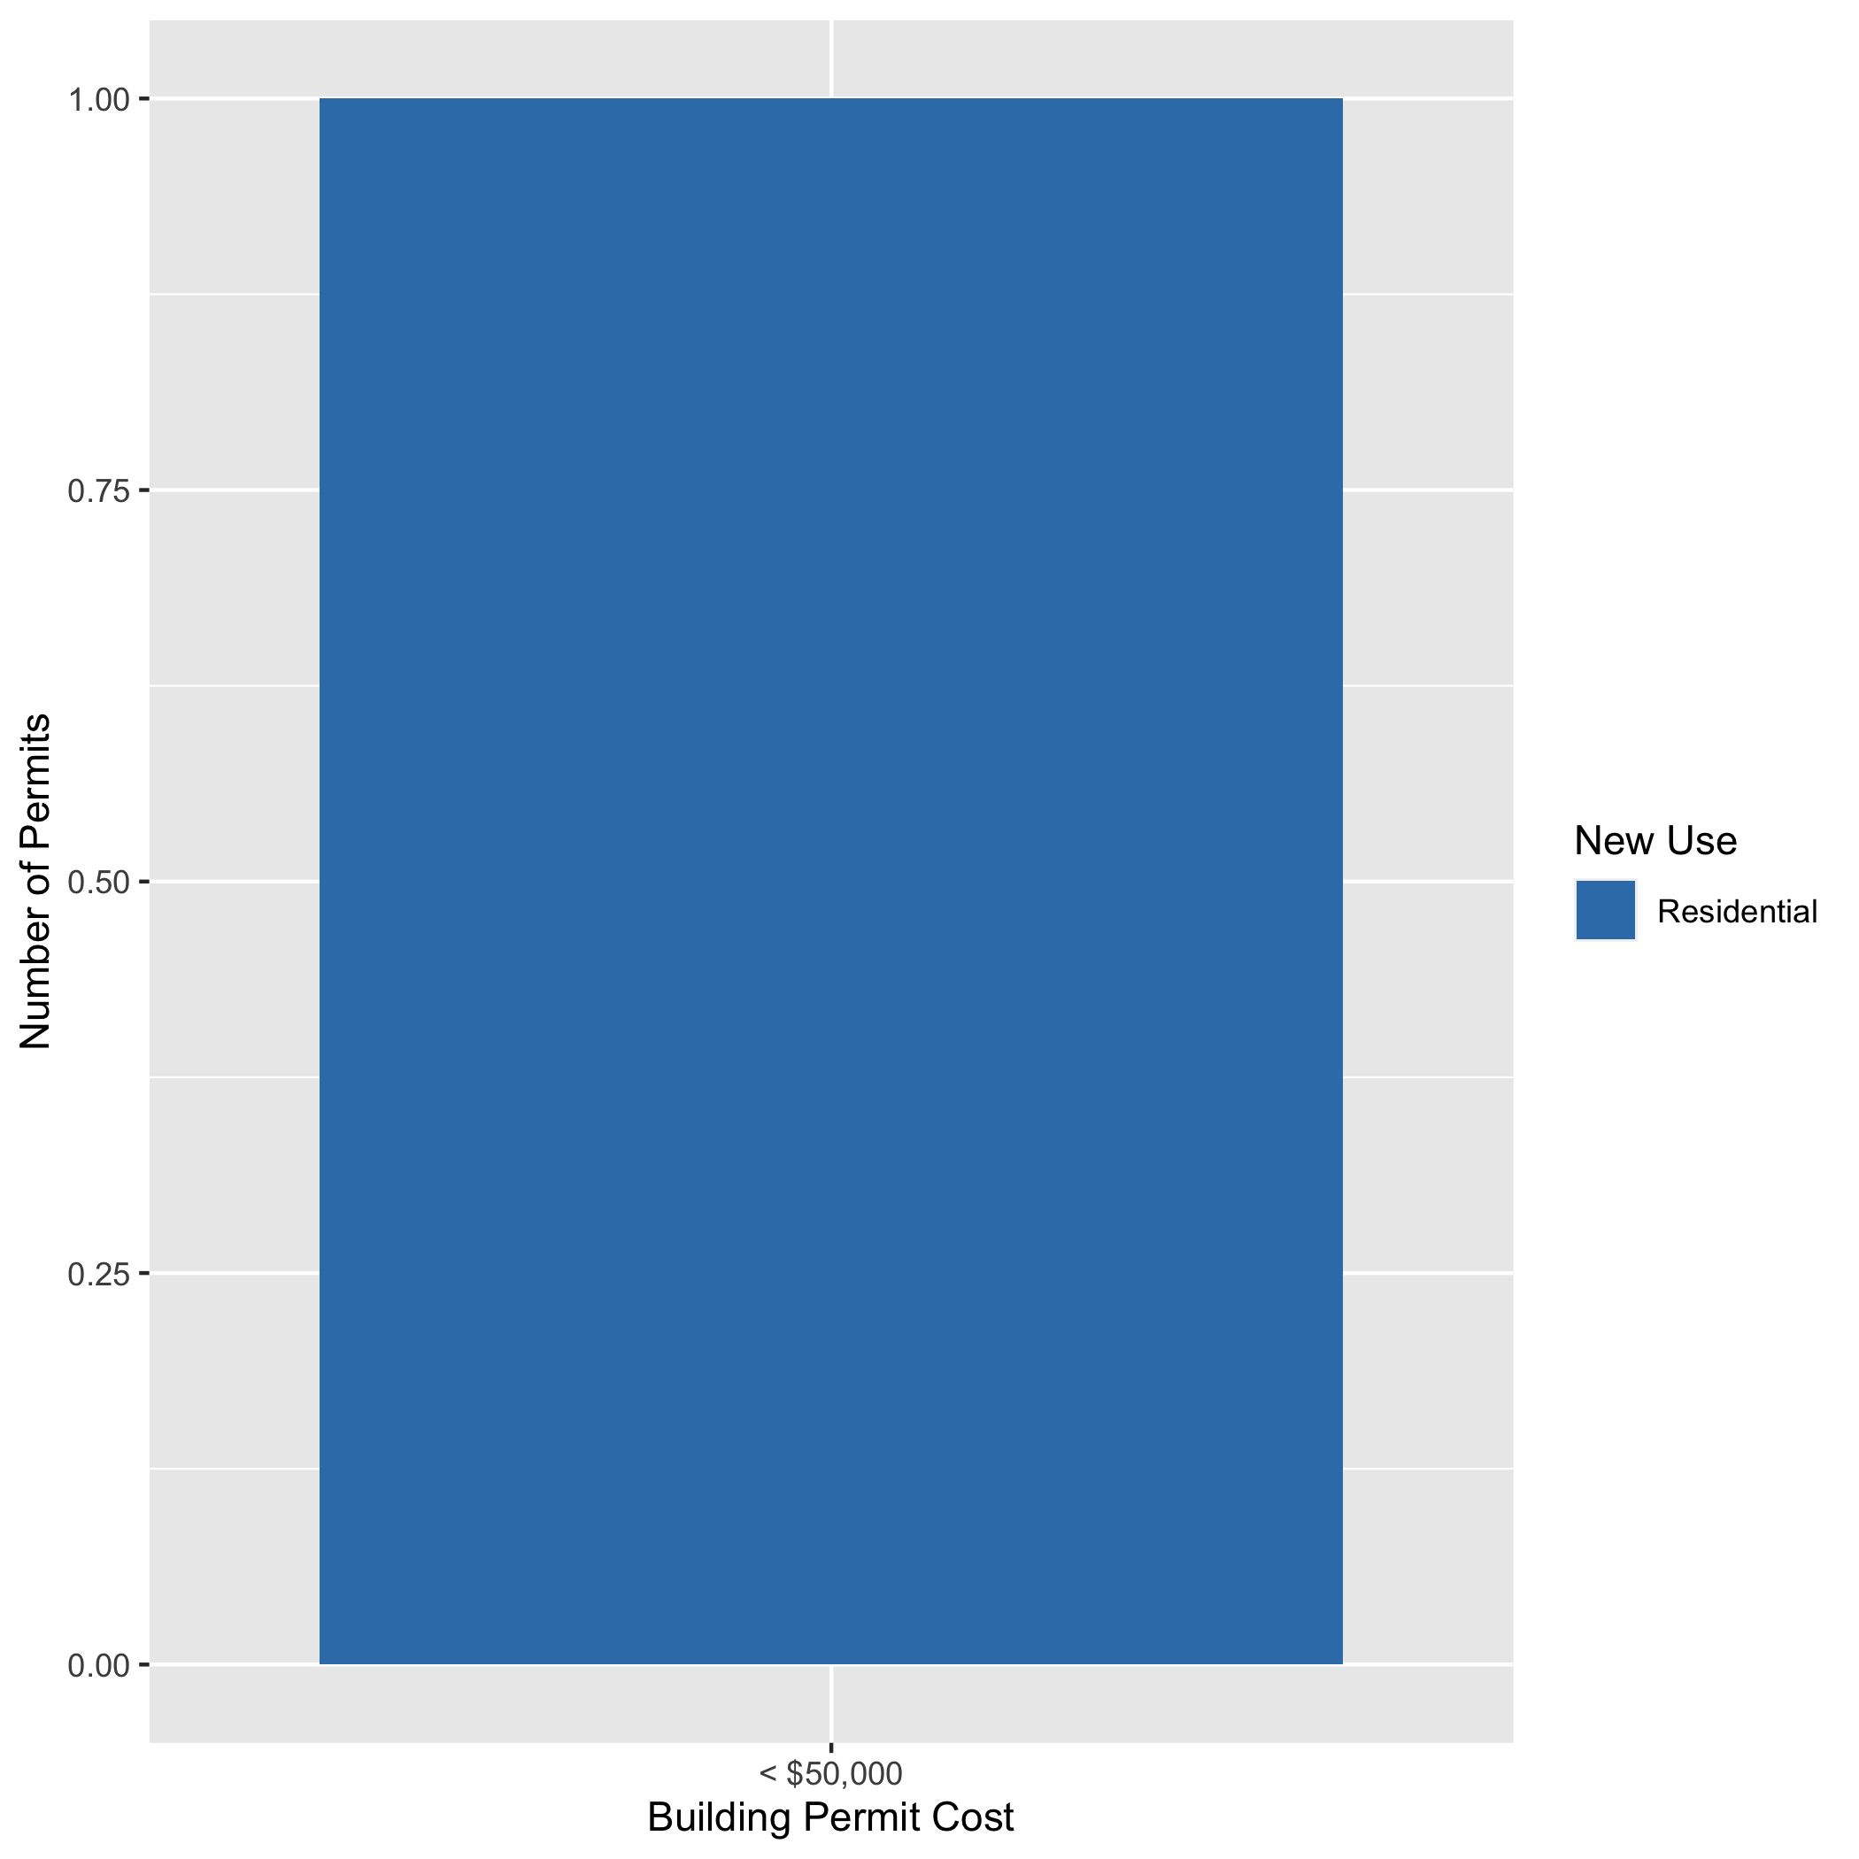
Lewis Place High Cost Permits

Slide 50
Vandeventer: Summary Notes
2 building permits in Vandeventer in January 2020
-50.00% change compared to January 2019 (4 total building permits)
$102,500 : Average building permit cost in Vandeventer in January 2020
391.25% change compared to January 2019 ($20,865)

Slide 51
Vandeventer: Summary Notes
2 total building permits in Vandeventer in 2020
-50.00% change compared to this time in 2019 (4 total building permits)
$102,500 : Average building permit cost in Vandeventer in 2020
391.25% change compared to this time in 2019 ($20,865)

Slide 52
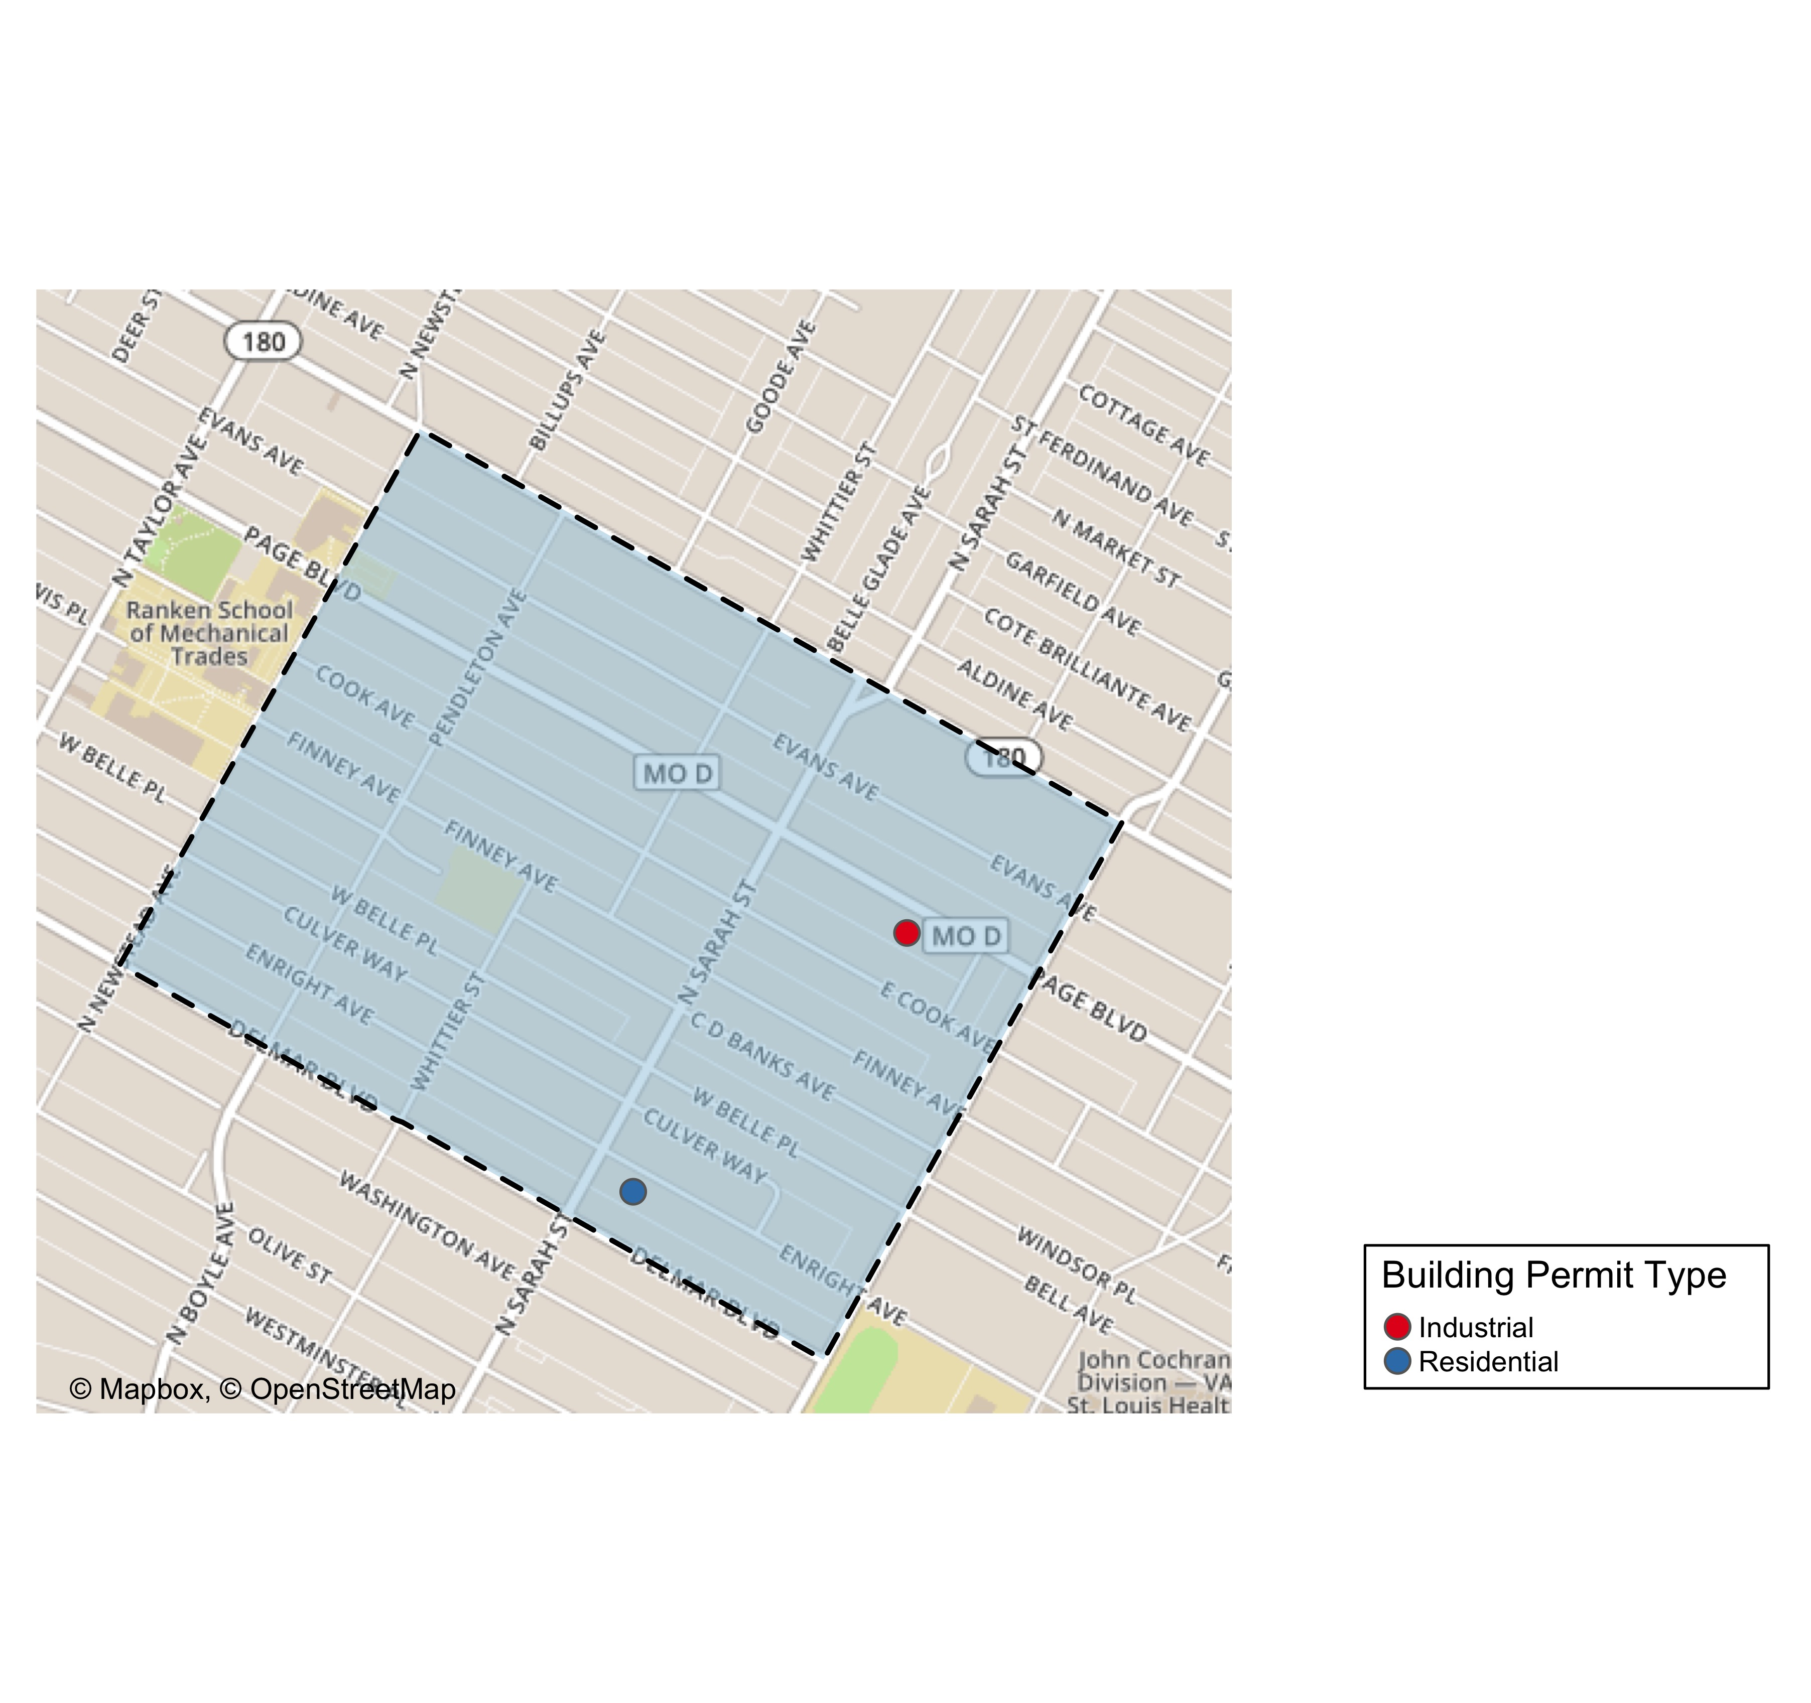
Vandeventer

Slide 53
Vandeventer
New Use | Average Cost | # of Permits
Industrial | $55,000 | 1
Residential | $150,000 | 1

Slide 54
Vandeventer Individual Permit Breakdown
Owner | New Use | Cost | Address
LOTT, JAMALIA | Residential | $150,000 | 4050 ENRIGHT AV
BROWN, TONY C SR & SHARON D BROWN | Industrial | $55,000 | 3960-66 PAGE BLVD

Slide 55
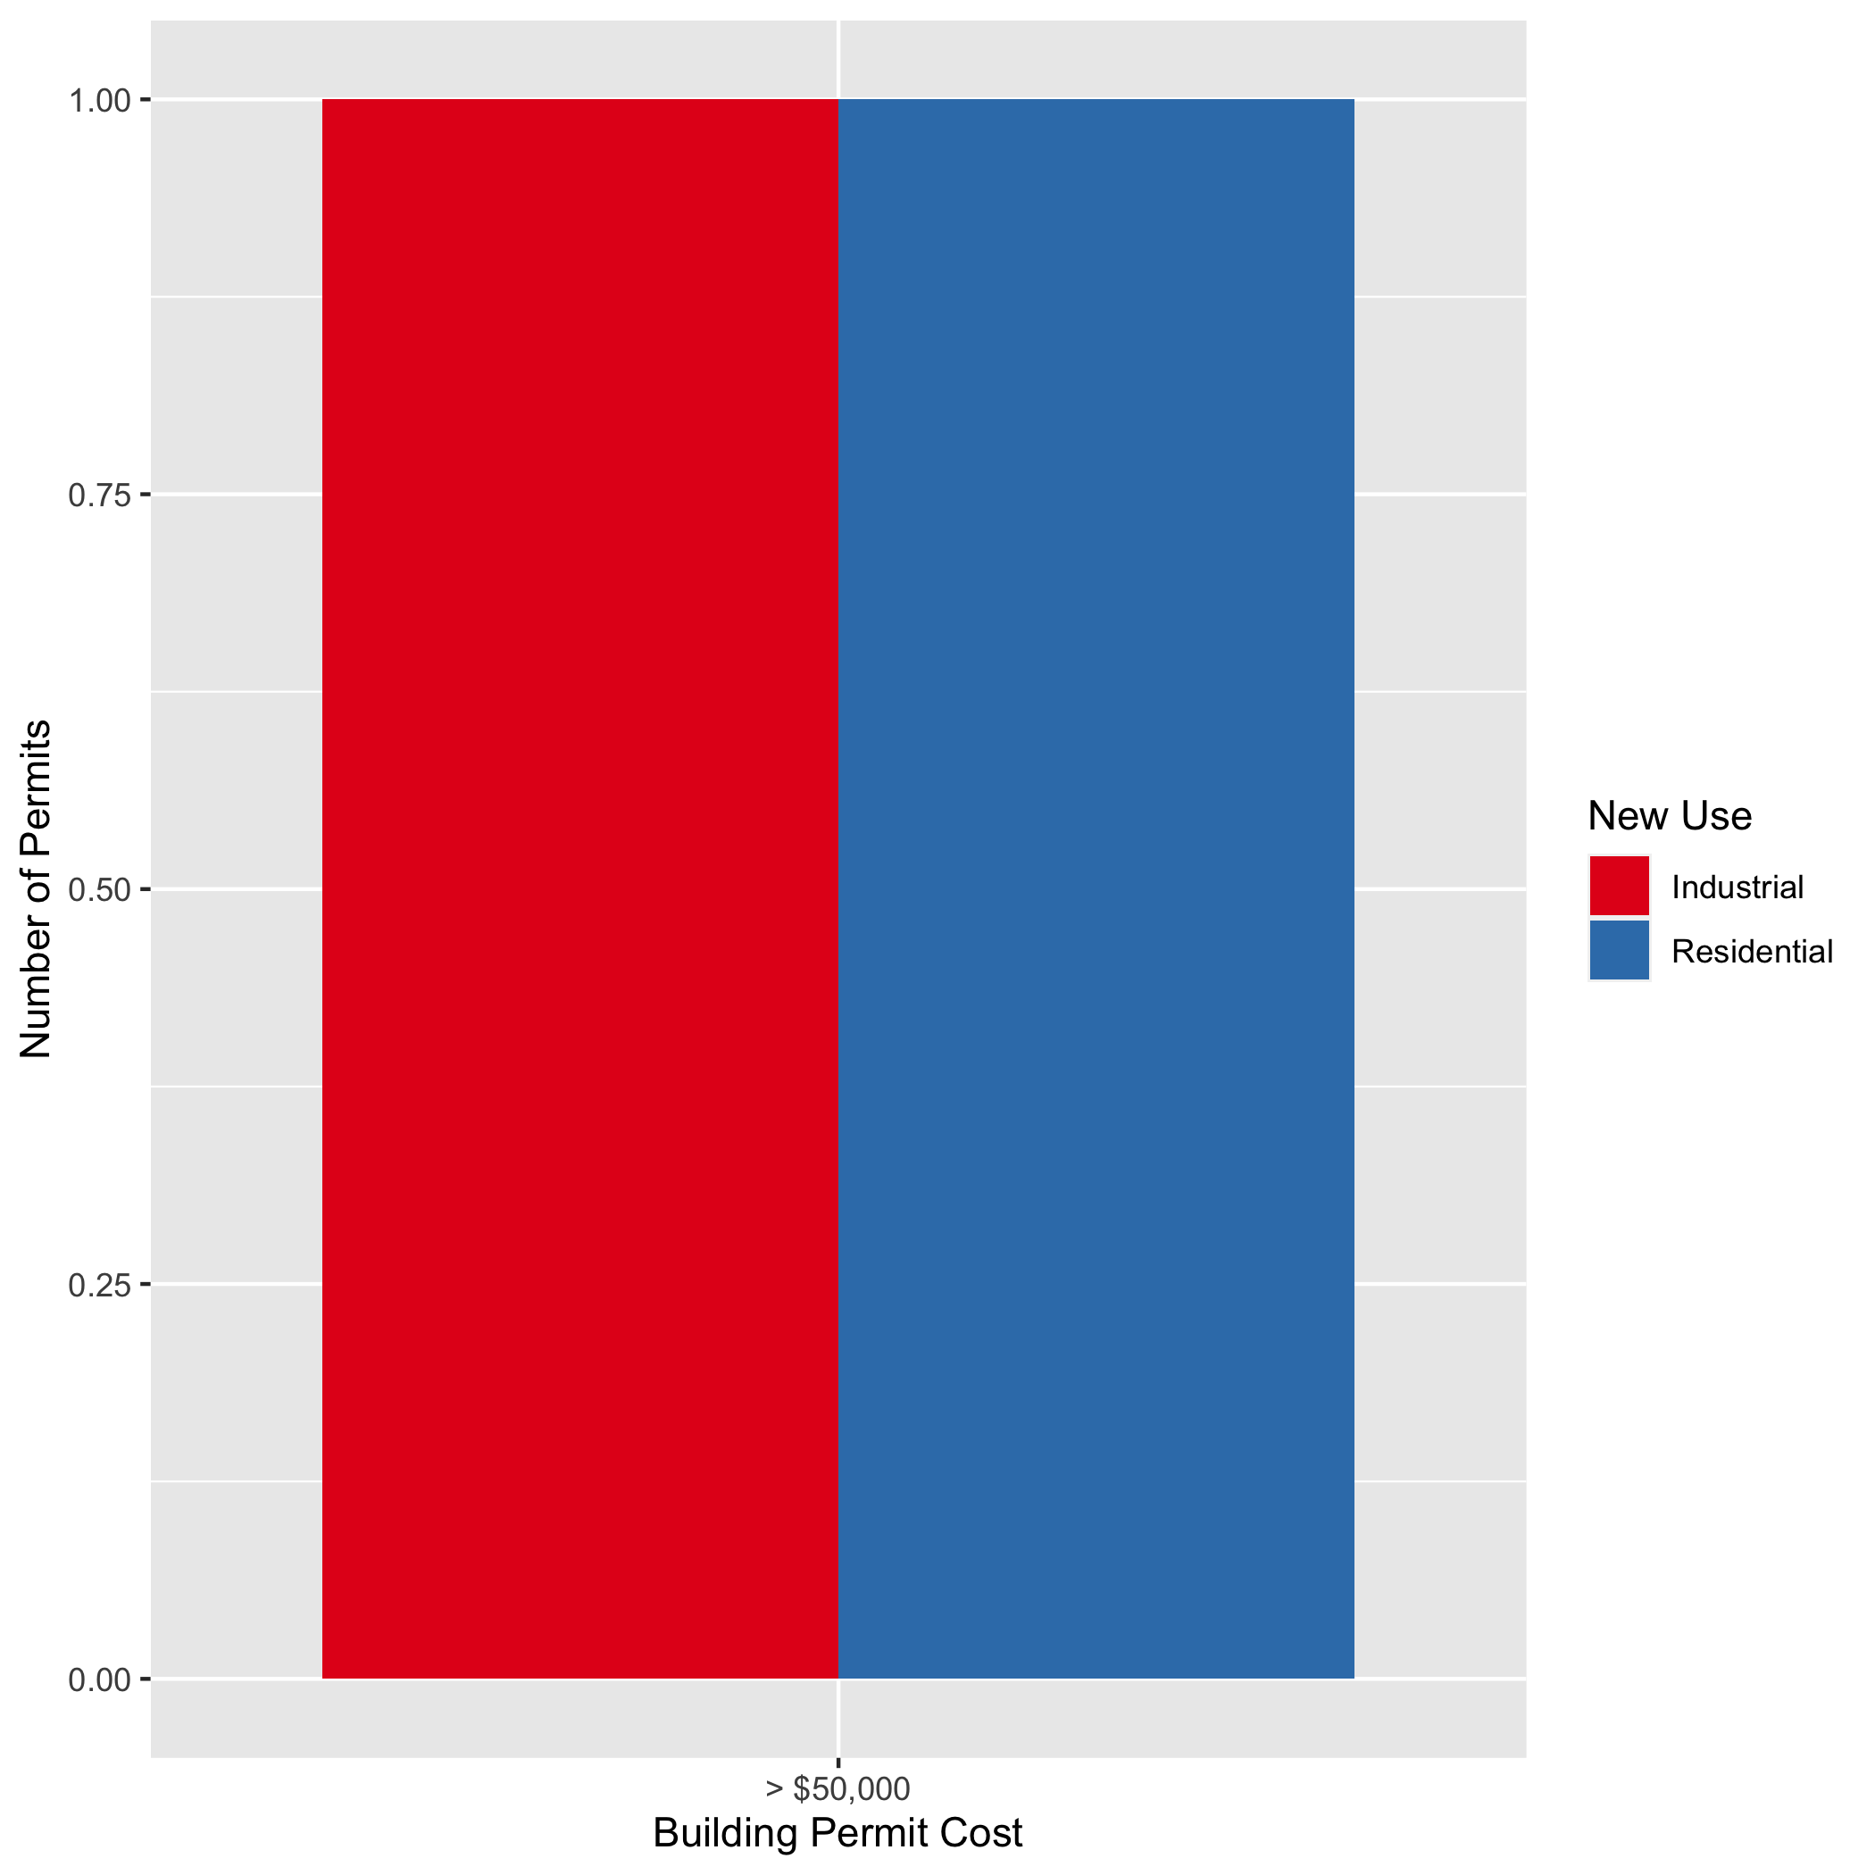
Vandeventer High Cost Permits

